Slide 1
Spotify Music Recommendation System
TSP- AI ML Fundamentals (Capstone Project)
Presented By:
Preethi V – au810021214022
Guided By: Ramar Bose Sr. AI Master Trainer

Slide 2
OUTLINE
Problem Statement
Proposed System/Solution
Algorithm & Deployment
GitHub Link
Project Demo(photos / videos)
Conclusion
Future Scope
References

Slide 3
Problem Statement
The Spotify Music Recommendation System is designed to offer users personalized song suggestions tailored to their musical tastes. Utilizing machine learning methods and the vast Spotify dataset, the system examines song characteristics such as danceability, energy, and tempo to categorize songs into clusters with similar attributes. Users engage with the system by inputting their favorite song and, optionally, indicating a preferred genre. Subsequently, the system generates carefully curated lists of recommended tracks that closely match the user's preferences. Critical objectives of the system encompass precise recommendation generation, streamlined data analysis, and preprocessing, intuitive user interaction, and scalability to manage extensive data volumes.. Furthermore, the system aspires to continuously enhance its recommendation capabilities, adapting to evolving user preferences and delivering increasingly refined suggestions over time.

Slide 4
Proposed Solution
The proposed solution utilizes the Spotify songs dataset sourced from Kaggle to craft personalized song recommendations. Through the utilization of K-Means clustering, data points are organized based on attributes such as danceability, energy, and tempo, aiding in the identification of songs with similar characteristics. Users provide their favorite songs and, optionally, specify preferred genres to fine-tune recommendations. Utilizing the clustering model, the system proposes songs from the same cluster as the user's favorite, ensuring alignment with their musical tastes. Implemented as a standard Python application, the recommender system ensures easy accessibility for users. Continuous refinement, driven by user feedback and performance evaluations, enhances the system's accuracy, thereby enriching the overall music discovery journey for Spotify users.

Slide 5
Algorithm & Deployment
• Data Analysis and Processing: Processing and analyzing the Spotify dataset to extract relevant features for recommendation.
• Machine Learning: Implementing the K-Means clustering algorithm for grouping songs into clusters based on their attributes.
• User Interface Design: Designing an interactive interface for users to input their favorite songs and preferred genres.
• Model Deployment: Deploying the recommendation system as a standalone Python application for user accessibility.
• Package Installation: Ensuring the availability and installation of required packages such as pandas, numpy, plotly, yellowbrick for data manipulation, visualizations, clustering respectively.

Slide 6
GitHub Link
https://github.com/preethi4330/spotify-music-recommendation

Slide 7
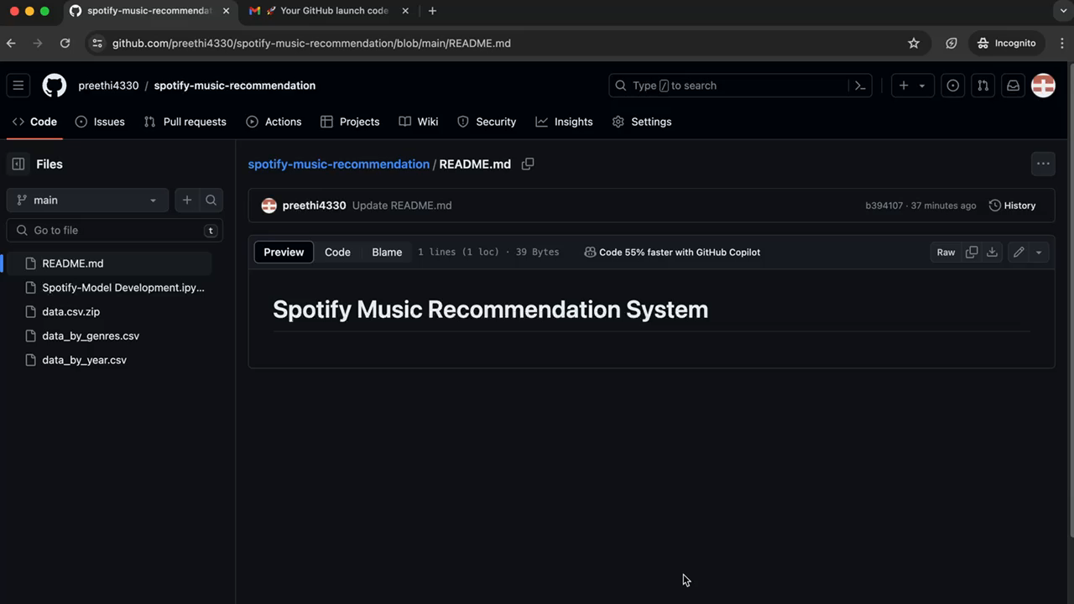
Project Demo(Recorded Video)

Slide 8
Conclusion
The Spotify Music Recommendation App represents a groundbreaking fusion of advanced machine learning and user-centric design, reshaping how users explore music. Its sophisticated recommendation engine analyzes user data using techniques like collaborative filtering, crafting tailored suggestions that enhance the listening experience. With its seamless deployment across platforms and devices, the app has gained widespread adoption, revolutionizing personalized music discovery within the Spotify ecosystem.

Slide 9
Future Scope
To boost recommendation precision, Spotify's system could explore diverse machine learning methods like matrix factorization and deep learning. Combining these with collaborative filtering and content-based recommendation could capture intricate user preferences better. Enhancing the interface with social features and advanced filtering options would cater to varied user tastes, fostering a more engaging and tailored music discovery journey. Integrating collaborative and content-based filtering methods could further enrich recommendation accuracy by leveraging both user behavior and item attributes.

Slide 10
References
Project Github link, Ramar Bose , 2024
Project video recorded link (youtube/github), Ramar Bose , 2024
Project PPT & Report github link, Ramar Bose , 2024

Slide 11
THANK YOU

